Slide 1
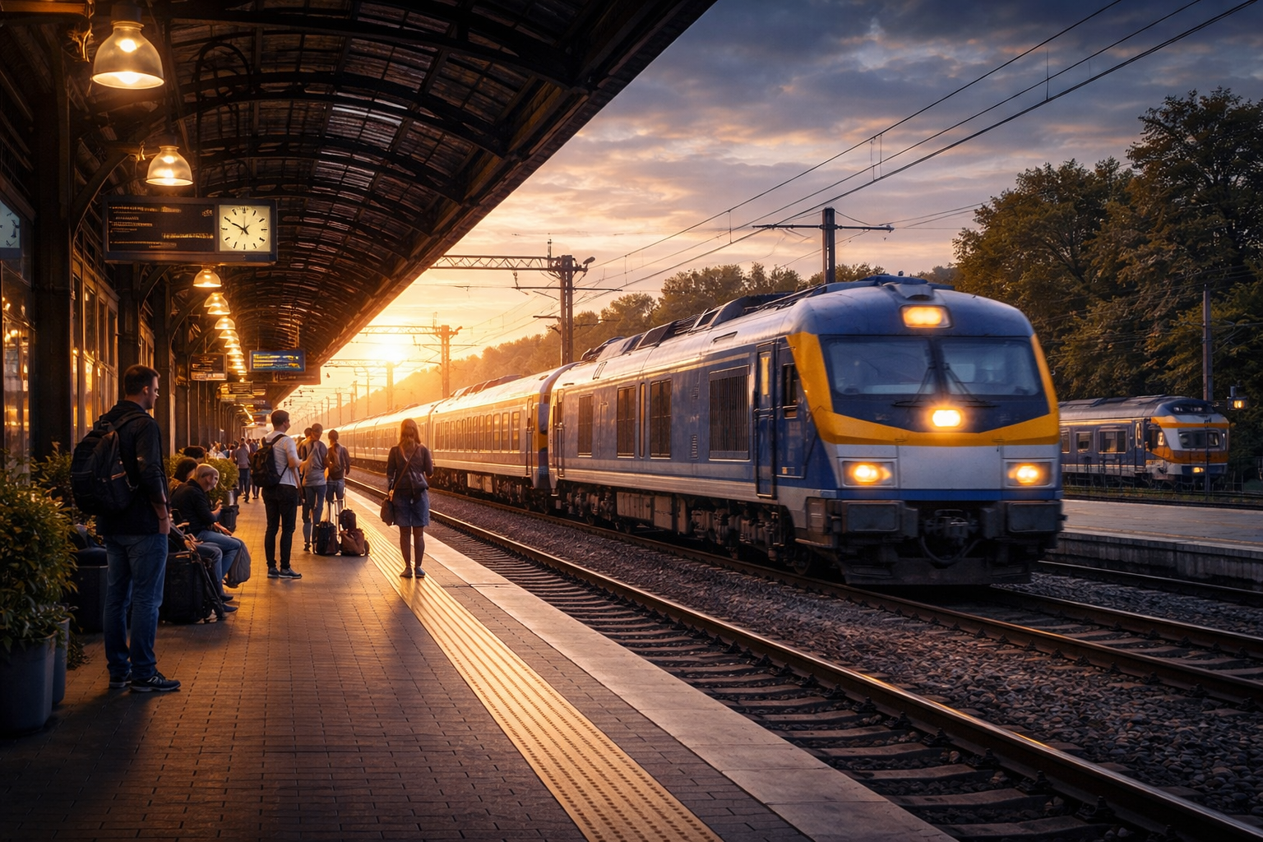
TOOLS USED
RAILWAY MANAGEMENT SYSTEM
PRESENTED BY : NISHA VALAND

Slide 2

INTRODUCTION & PROJECT OVERVIEW
The Railway Booking Management and Analysis System is an SQL-based project developed to efficiently manage and analyze railway booking data.
The project focuses on understanding passenger travel behavior, booking trends, and operational performance of trains.
The database is designed using four core tables: Train, Route, Booking, and Payment, which store complete information about trains, travel routes, passenger bookings, and payment transactions.
Relationships between these tables help in tracking journeys from source to destination along with fare and payment details.
Various SQL queries are used to analyze:
Most popular source–destination routes
Trains with the highest number of cancelled bookings
Passenger preferences across different seat classes
Total distance travelled by passengers
This project demonstrates practical use of SQL concepts such as joins, aggregation functions, grouping, filtering, and sorting to extract meaningful insights.
Overall, the system helps in better data management, analysis, and decision-making in railway operations.

Slide 3
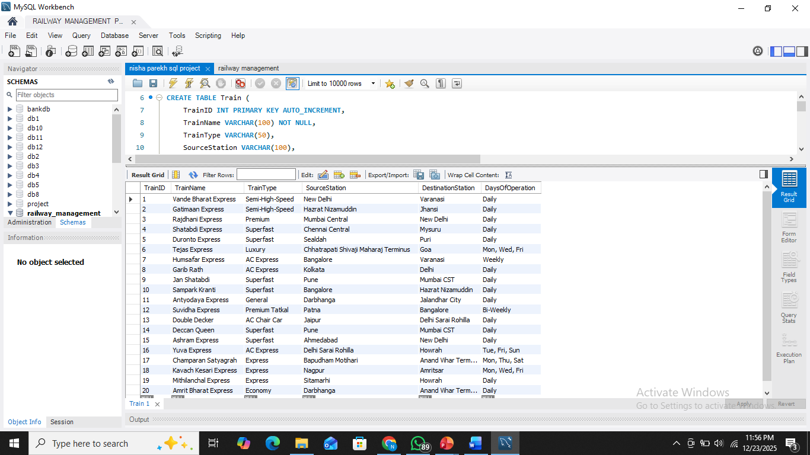
Train Table
CREATE TABLE TRAIN ( TRAINID INT PRIMARY KEY AUTO_INCREMENT,
TRAINNAME VARCHAR(100) NOT NULL,
TRAINTYPE VARCHAR(50),
SOURCESTATION VARCHAR(100),
DESTINATIONSTATION VARCHAR(100),
DAYSOFOPERATION VARCHAR(50));
QUERY
SUMMARY : Shows train details ID, name, type, start & end stations, and days of running. Train ID gives a unique number for each train. Helps to check train schedules and types. Used with Booking, Route, and Payment tables.

Slide 4
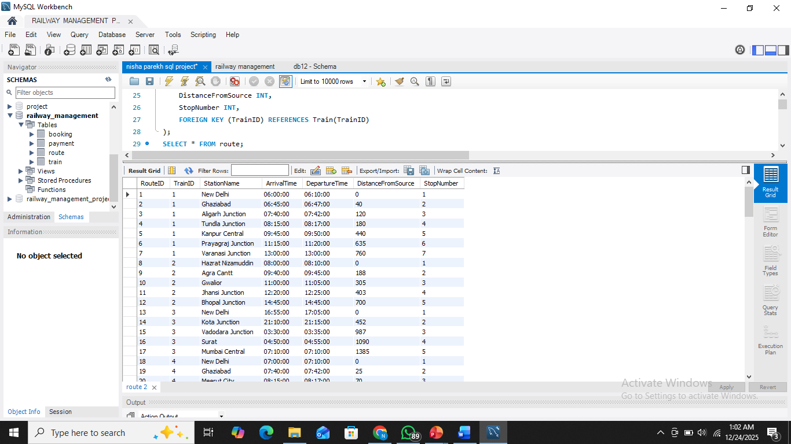
Route Table
CREATE TABLE Route (RouteID INT PRIMARY KEY AUTO_INCREMENT,
TrainID INT,
StationName VARCHAR(100),
ArrivalTime TIME,
DepartureTime TIME,
DistanceFromSource INT,
StopNumber INT,
FOREIGN KEY (TrainID) REFERENCES Train(TrainID));
QUERY
SUMMARY : The table has 120 rows for all stations of 20 trains. Shows station name,arrival & departure times, distance, and stop number. TrainID links each route to its train. Helps in train schedule and route management.

Slide 5
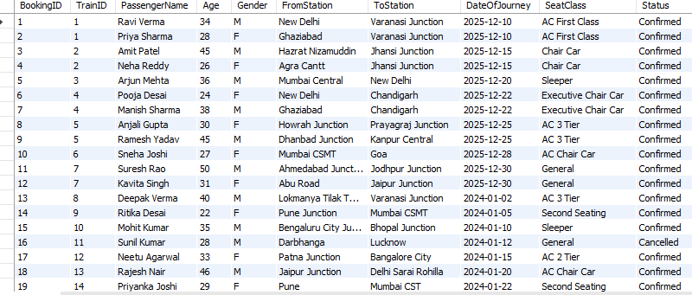
Booking Table
CREATE TABLE Booking ( BookingID INT PRIMARY KEY AUTO_INCREMENT, TrainID INT,
PassengerName VARCHAR(100),
Age INT, Gender VARCHAR(10),
FromStation VARCHAR(100), ToStation VARCHAR(100),
DateOfJourney DATE,
SeatClass VARCHAR(50), Status VARCHAR(20),
FOREIGN KEY (TrainID) REFERENCES Train(TrainID));
QUERY
SUMMARY : The table has 200 rows of train booking records. Stores passenger details, from & to stations, journey date, and seat class. TrainID connects each booking to a train. Status shows booking confirmation.

Slide 6
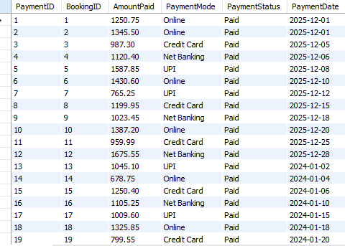
Payment Table
CREATE TABLE Payment ( PaymentID INT PRIMARY KEY,
BookingID INT,
AmountPaid DECIMAL(10,2),
PaymentMode VARCHAR(50),
PaymentStatus VARCHAR(20),
PaymentDate DATE,
FOREIGN KEY (BookingID) REFERENCES Booking(BookingID));
QUERY
SUMMARY : The table has 200 rows of payment records. Stores payment amount, payment mode, status, and date. Each payment is linked to a booking using BookingID. Used to track and manage booking payments.

Slide 7
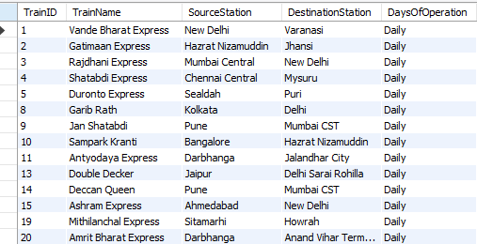
1. List all trains that operate daily.
select TrainID,TrainName,SourceStation,DestinationStation, DaysOfOperation
from Train
where DaysOfOperation = 'Daily';
QUERY
SUMMARY : This query lists all trains that operate daily. It fetches train name, source station, destination station, and operation days. Uses a filter to show only trains with DaysOfOperation = 'Daily'. Helps identify regularly running trains

Slide 8
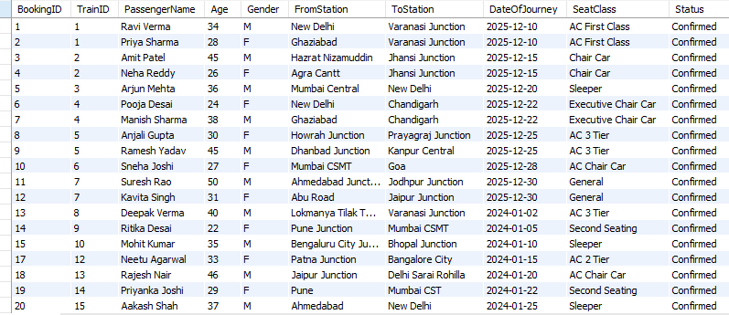
2. Show all confirmed bookings.
select * from booking
where Status = 'Confirmed’;
QUERY
SUMMARY : This query shows all confirmed bookings . It filters records where Status ='Confirmed’. Total confirmed bookings: 188 rows. Useful for checking successful reservations.

Slide 9
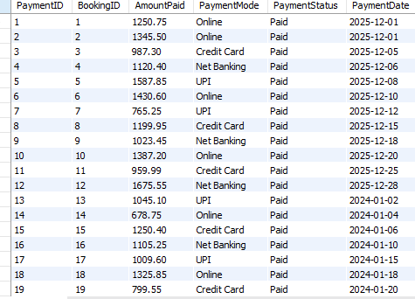
3. Show paid payment records.
select * from payment
where PaymentStatus = 'Paid';
QUERY
SUMMARY : This query shows all paid payment records. It filters data where PaymentStatus ='Paid'. Total paid records: 200 rows. Used to track successful payments.

Slide 10
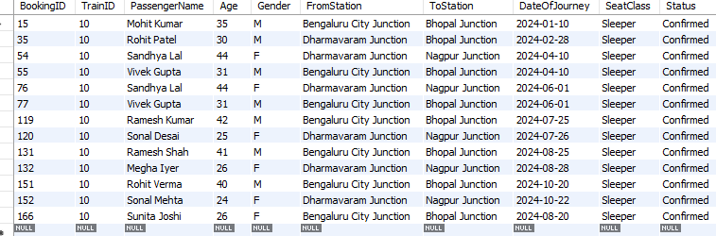
4. Bookings for a specific train
select * from booking
where TrainID = '10';
QUERY
SUMMARY : This query shows all bookings for a specific train (TrainID = 10).It filters booking records by the given TrainID. Total bookings found: 13 rows. It helps to view train-wise booking details.

Slide 11
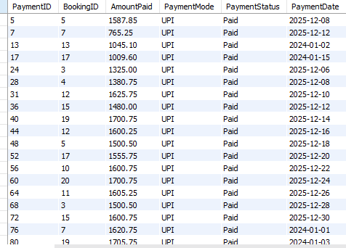
5. Payments done using UPI
select * from payment
where paymentMode = 'UPI';
QUERY
SUMMARY : This query shows all payments made using UPI. It filters records where PaymentMode = 'UPI'. Total UPI payments: 49 rows. It helps analyze UPI-based transactions.

Slide 12
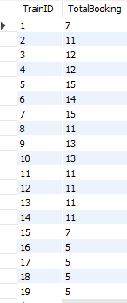
6. Booking count train-wise
select TrainID ,count(*) AS TotalBooking
from booking
Group by TrainID;
QUERY
SUMMARY : This query shows the total booking count for each train.It groups booking records by TrainID and counts bookings.Total rows: 20 (one row per train).For TrainID = 20, the total bookings are 5.It helps analyze train-wise booking performance

Slide 13

7. Total revenue from paid payments
QUERY
select sum(AmountPaid) as TotalRevenue
from payment
where PaymentStatus = 'paid';
SUMMARY : This query calculates the total revenue from paid payments. It sums the AmountPaid where PaymentStatus = 'Paid'. Total revenue generated: 307,279.09. It helps analyze overall income from bookings.

Slide 14

8. Write an SQL query to calculate month-wise total revenue from the payment table for the year 2025.
select month(PaymentDate) as Month , sum(AmountPaid) as TotalRevenue
From payment
where year(paymentDate) = '2025’
group by month(PaymentDate);
QUERY
SUMMARY : This query calculates the month-wise total revenue from the payment table for the year 2025. It groups payments by month and sums the AmountPaid. For December (Month 12), the total revenue is 95,163.54.It helps analyze monthly revenue trends.

Slide 15

9. Calculate the average ticket amount paid by passengers for confirmed and paid bookings.
QUERY
select avg(AmountPaid) AS AVRAGE
from payment
where paymentStatus = 'paid';
SUMMARY : This query calculates the average ticket amount paid by passengers. It considers only records where PaymentStatus = 'Paid’. The average amount paid per ticket is 1536.39.
It helps understand the typical ticket cost for successful booking

Slide 16
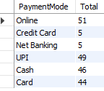
10. Display the total number of payments made using each payment mode such as UPI, Card, or Cash.
select PaymentMode,count(*) as Total
from payment
group by PaymentMode;
QUERY
SUMMARY : This query shows the total number of payments made using each payment mode. It groups records by PaymentMode such as UPI, Card, Cash, Online, etc. The result helps identify the most commonly used payment method by passengers

Slide 17
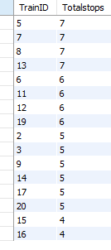
11. Find the train which has the maximum number of stops in its route.
SELECT TrainID,count(*) as Totalstops
from route
group by TrainID
order by Totalstops desc;
QUERY
SUMMARY : This query finds the trains with the maximum number of stops (7 stops). It groups the data by TrainID, counts total stops for each train, and sorts the result in descending order to identify the trains with the highest number of stops.

Slide 18
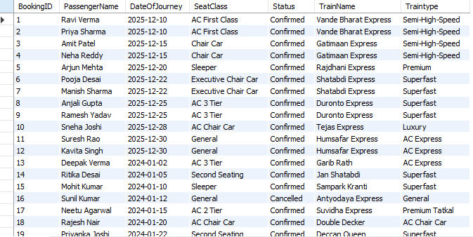
12. Display booking details along with train name and train type by joining Train and Booking tables.
Select B.BookingID,B.PassengerName,B.DateOfJourney,B.SeatClass,
B.Status,T.TrainName,T.Traintype
From booking as B
join Train as T
on B.TrainID = T.TrainID
order by BookingID;;
QUERY
SUMMARY ; This query retrieves booking details along with train name and train type by joining the Booking and Train tables on TrainID. It displays all 200 booking records, ordered by BookingID. The result helps understand passenger bookings and identify which type of train each passenger has booked.

Slide 19
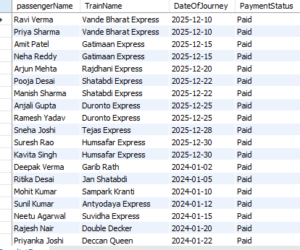
13. Retrieve passenger name, train name, journey date, and payment status.
select B.passengerName,T.TrainName,B.DateOfJourney,P.PaymentStatus
from booking as B
Join Train as T
on B.TrainID = T.TrainID
join payment as P
on B.BookingID = P.BookingID;
QUERY
SUMMARY ; This query shows passenger name, train name, journey date, and payment status by joining the Booking, Train, and Payment tables . It returns 200 rows, covering all bookings with their payment details.

Slide 20

14. Find the train which has the maximum number of bookings.
select T.TrainName,count(BookingID) as TotalBookings
From booking as b
join Train as T
on B.TrainID = T.TrainID
group by TrainName
order by TotalBookings desc
limit 1;
QUERY
SUMMARY ; This query finds the train with the maximum number of bookings by grouping booking records by TrainName and counting total bookings. The result shows that Duronto Express has the highest bookings with a total of 15. It helps identify the most popular train based on passenger bookings.

Slide 21
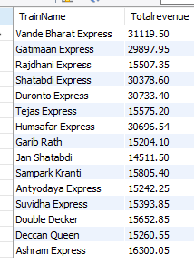
15. Calculate total revenue generated by each train.
select T.TrainName,sum(P.AmountPaid) As Totalrevenue
From Train as T
join Booking as B
on B.TrainID = T.TrainID
join Payment as P
on B.BookingID = P.BookingId
where PaymentStatus = 'paid’
group by TrainName;
QUERY
SUMMARY ; This query calculates the total revenue generated by each train by joining the Train, Booking, and Payment tables. It considers only paid payments (PaymentStatus = 'Paid') and sums the AmountPaid for each train. The result shows one row per train, giving the total revenue earned by that train.

Slide 22
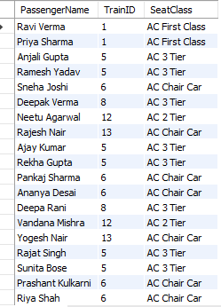
16. Display the list of passengers who traveled in AC class.
select PassengerName,TrainID,SeatClass
From booking
where SeatClass Like '%AC%' ;
QUERY
SUMMARY; This query retrieves passengers who traveled in AC class by selecting booking records where the SeatClass includes “AC”. It displays Passenger Name, TrainID, and Seat Class details.The result contains 79 rows, representing all passengers who booked AC-class seats.

Slide 23

17. Find the passenger who has paid the highest total amount
select B.PassengerName,sum(AmountPaid) as TotalPaid
from booking as B
join Payment as p
on B.BookingID = P.BookingID
where PaymentStatus = 'paid’
group by B.passengerNameorder by TotalPaid desc
Limit 1 ;
QUERY
SUMMARY; This query identifies the passenger who paid the highest total amount by summing paid payments for each passenger. The result shows Aakash Shah as the top payer with a total of 16300.05.

Slide 24
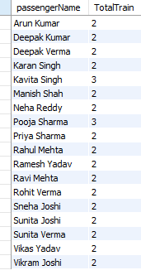
18. Passengers who booked more than one train
select passengerName ,count(distinct TrainID) as TotalTrain
from booking
group by PassengerName
Having count(distinct TrainID) > 1;
QUERY
SUMMARY; This query finds passengers who have booked tickets on more than one different train. Data is taken from the booking table. Records are grouped by PassengerName. COUNT(DISTINCT TrainID) counts how many different trains each passenger booked. HAVING COUNT(DISTINCT TrainID) > 1 ensures only passengers with multiple train bookings are shown

Slide 25
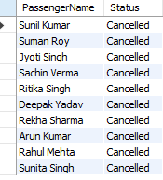
19. Display passengers who cancelled bookings
select distinct PassengerName,Status
from booking
where status = 'cancelled';
QUERY
SUMMARY; This query displays all passengers who cancelled their bookings. It filters records where Status = 'Cancelled’. The DISTINCT keyword avoids duplicate passenger names. Useful for analyzing cancellation patterns and passenger behavior

Slide 26

20. Count bookings based on gender
select Gender,count(*) as TotalBooking
from booking
group by gender;
QUERY
SUMMARY; This query counts the total number of bookings based on gender. It groups records using the Gender column. The result shows booking distribution between Male (M) and Female (F) passengers. Useful for understanding gender-wise travel patterns

Slide 27
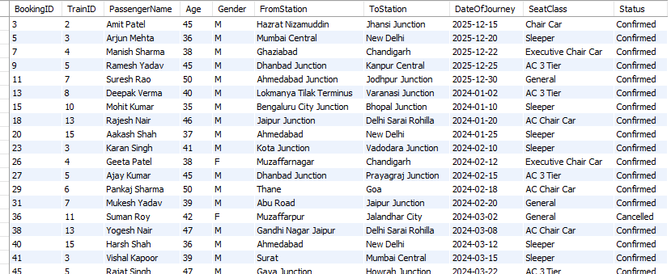
21. Display bookings where passenger age is above average age
select *from booking
where age >
(select AVG(Age) from booking);
QUERY
SUMMARY; This query displays all bookings where the passenger’s age is greater than the average age of all passengers.It uses a subquery with AVG(Age) to calculate the average age.Only records with Age above average are selected.Total records returned: 87 rows.Helpful for analyzing older passengerbooking trends.

Slide 28
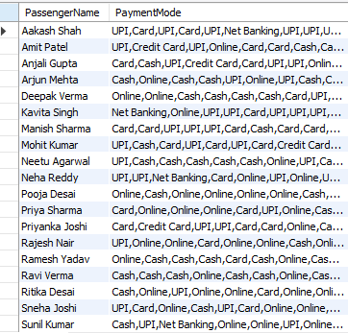
22. Identify passengers who have used more than one
payment mode for their bookings and display their names
along with one of the payment modes used.
select B.PassengerName,group_concat(P.PaymentMode) AS PaymentMode
from Booking as B
join Payment as p
on B.BookingId = P.BookingID
group by B.PassengerName
having count(distinct P.PaymentMode) >1 ;
QUERY
SUMMARY; This query finds passengers who used more than one payment mode. It joins Booking and Payment tables using BookingID. GROUP_CONCAT shows all payment modes used by each passenger. HAVING COUNT(DISTINCT PaymentMode) > 1 filters such passengers.It helps understand multiple payment usage patterns of passengers.

Slide 29

23. Identify the date on which the highest number of bookings were made in the system.
select DateOfJourney,count(*) as TotalBooking
from booking
group by DateOfJourney
order by TotalBooking desc;
QUERY
SUMMARY; This query groups bookings by DateOfJourney. It counts total bookings for each date. Results are sorted in descending order. The date with the highest bookings comes first.2024-07-05 has the maximum bookings (3).

Slide 30
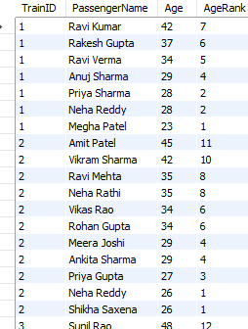
24. Show each passenger for a train along with their rank based on age (oldest → youngest).
select TrainID,PassengerName,Age,
RANK() over(Partition by TrainID order by Age) as AgeRank
from booking
order by TrainID,AgeRank desc;
QUERY
SUMMARY; This query shows passengers for each train with their age-based rank. Passengers are ranked from oldest to youngest within each train. Ranking restarts separately for every TrainID. The oldest passenger in a train gets Rank 1.The result is sorted by TrainID and then by Age (descending).Total rows returned: 200.

Slide 31

25. Find passengers who have both confirmed and cancelled bookings
select PassengerName
from booking
group by PassengerName
Having sum(Status = 'Confirmed') > 0 AND sum(Status = 'Cancelled') > 0;
QUERY
SUMMARY; This SQL query is used to identify passengers who have made at least one confirmed booking and at least one cancelled booking . It groups the data by passenger name and applies conditions to ensure both booking statuses exist for the same passenger. The final result shows passengers like Rahul Mehta and Arun Kumar, who have experienced both confirmed and cancelled bookings.

Slide 32
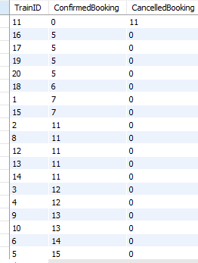
26. Train-wise Confirmed vs Cancelled booking count
select TrainID,sum(Status = 'Confirmed') as ConfirmedBooking,
sum(Status = 'Cancelled') as CancelledBooking
from booking
group by TrainID
order by ConfirmedBooking,CancelledBooking desc;
QUERY
SUMMARY;This SQL query calculates the number of confirmed and cancelled bookings for each train by grouping the data using TrainID. It summarizes booking activity on a train-wise basis and orders the results for better comparison. The final output contains 20 rows, representing booking details for 20 different trains, which helps analyze booking trends and cancellation patterns across trains.

Slide 33
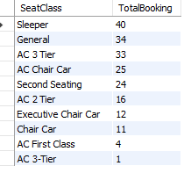
27. Find the most preferred seat class
select SeatClass,count(*) as TotalBooking
from booking
group by SeatClass
order by TotalBooking desc;
QUERY
SUMMARY; This SQL query finds the most preferred seat class by counting total bookings for each seat type. It groups the data by SeatClass and sorts the results in descending order.The output shows that Sleeper class has the highest number of bookings. This indicates that Sleeper is the most popular choice among passengers.

Slide 34
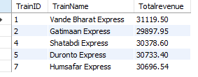
28. Find train-wise total revenue and show only those trains whose revenue is above average.
with Trainrevenue as(select T.TrainID,T.TrainName,sum(p.AmountPaid) as Totalrevenue
from Train as T
join booking as B on B.TrainID = T.TrainID
join Payment as p on B.BookingID = p.BookingID
where p.PaymentStatus = 'Paid’
group by T.TrainID,T.TrainName)
select* from Trainrevenuewhere Totalrevenue > (select avg(Totalrevenue) from Trainrevenue);
QUERY
SUMMARY; This SQL query calculates the total revenue for each train by joining train, booking, and payment tables. It considers only paid bookings and sums the amount paid for every train. The query then compares each train’s revenue with the average revenue. Only those trains whose total revenue is above average are shown in the final result

Slide 35
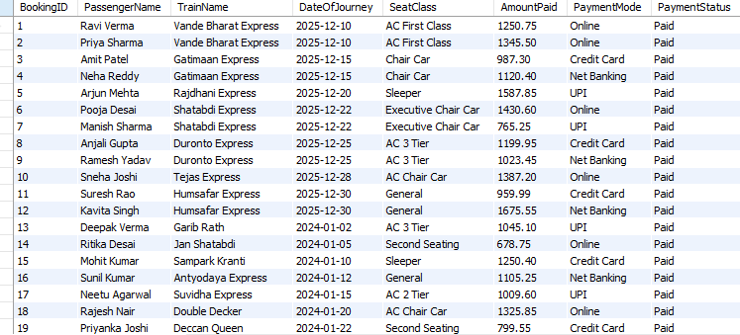
29. Create a VIEW to show booking, train, and payment summary.
create VIEW Booking_Train_Payment_Summary as select B.BookingID,B.PassengerName,T.TrainName,B.DateOfJourney,B.SeatClass,P.AmountPaid,P.PaymentMode,P.PaymentStatus
from booking as B
join train as T on B.TrainID = T.TrainID
join payment as Pon B.BookingID = P.BookingID;
select*from Booking_Train_Payment_Summary;
QUERY
SUMMARY; This SQL statement creates a VIEW that combines booking, train, and payment details into a single summary. It joins the booking, train, and payment tables using their related IDs.The view displays passenger name, train name, journey date, seat class, payment amount, mode, and status. This view makes it easier to view and analyze complete booking and payment information in one place. The final output contains 200 total rows, representing all booking records.

Slide 36
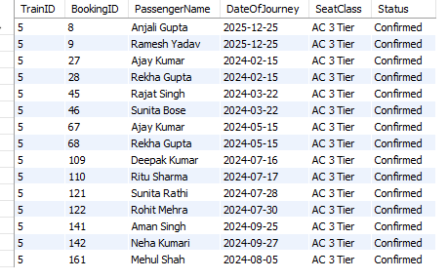
30. Create a stored procedure to display all bookings for a given TrainID.
DELIMITER //CREATE PROCEDURE getBookingByTrain(IN Train_ID INT)
BEGIN SELECT TrainID,BookingID,PassengerName,DateOfJourney,SeatClass,Status
from booking
where TrainID = Train_ID;
END //DELIMITER ;
CALL getBookingByTrain(5);
DROP PROCEDURE getBookingByTrain;
QUERY
SUMMARY; This stored procedure is created to display all bookings for a specific TrainID.It accepts Train_ID as an input parameter and retrieves booking details like passenger name, journey date, seat class, and status. The procedure can be executed using a CALL statement by passing the required TrainID.This makes it easy to fetch train-wise booking information whenever needed.

Slide 37
31. Automatically update booking status when payment is marked as Paid.
DELIMITER //
CREATE TRIGGER AFTERPAYMENTMODEAFTER UPDATE ON payment FOR EACH ROW
BEGIN IF NEW.PaymenTStatus = 'Paid' THEN
update booking
SET Status = 'Confirmed’
where BookingID = NEW.BookingID ;
END IF;
END //
DELIMITER ;
QUERY
NOTE ; This is a trigger, so it does not produce any direct output or result set . It works automatically in the background when a specific event occurs.
SUMMARY; This trigger automatically updates the booking status to “Confirmed” when the payment status is marked as “Paid”. It runs after an update on the payment table and checks each modified row.The trigger ensures data consistency between payment and booking tables.

Slide 38
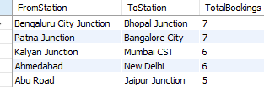
32. Find the top 5 most popular source–destination pairs based on the total number of bookings.
select FromStation,ToStation,count(*) as TotalBookings
from booking
group by FromStation,ToStation
order by TotalBookings desc
limit 5;
QUERY
SUMMARY; This query is used to find the top 5 most popular source–destination routes. Bookings are grouped by FromStation and ToStation.COUNT(*) calculates the total number of bookings for each route.
ORDER BY TotalBookings DESC sorts the routes from most to least booked. LIMIT 5 ensures that only the top 5 routes are displayed.

Slide 39

33. Cancelled Bookings by Train
SELECT T.TrainName,COUNT(*) AS CancelledBookings
FROM Booking B
JOIN Train T ON B.TrainID = T.TrainID
WHERE B.Status='Cancelled’
GROUP BY T.TrainName;
QUERY
SUMMARY; This query is used to find the number of cancelled bookings for each train. The Booking table is joined with the Train table using TrainID to get train names. The WHERE clause filters only those bookings whose status is 'Cancelled’. COUNT(*) calculates the total cancelled bookings for each train.
ROUP BY T.TrainName groups the results train-wise

Slide 40
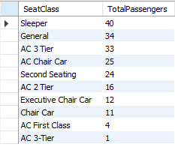
34.Passenger Count by Seat Class
SELECT SeatClass,COUNT(*) AS TotalPassengers
FROM Booking
GROUP BY SeatClass
order by TotalPassengers desc;
QUERY
SUMMARY; This query is used to find the total number of passengers for each seat class. The data is grouped by SeatClass from the Booking table. COUNT(*) calculates the number of passengers in each seat class. ORDER BY TotalPassengers DESC sorts the seat classes from highest to lowest passenger count.

Slide 41
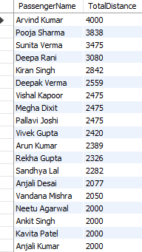
35. Total Distance Travelled by Each Passenger
SELECT B.PassengerName,SUM(R.DistanceFromSource) AS TotalDistance
FROM Booking B
JOIN Route R ON B.TrainID = R.TrainID
WHERE R.StationName IN (B.ToStation, B.FromStation)
GROUP BY B.PassengerName
order by TotalDistance desc;
QUERY
SUMMARY; This query calculates the total distance travelled by each passenger across all their journeys.
It joins the Booking and Route tables using TrainID. The distance travelled between source and destination stations is summed for every passenger. Results are grouped by PassengerName. Passengers are sorted in descending order based on total distance travelled. total number of rows returned: 160, meaning 160 passengers are included in the result

Slide 42
THYANK YOU

